Slide 1
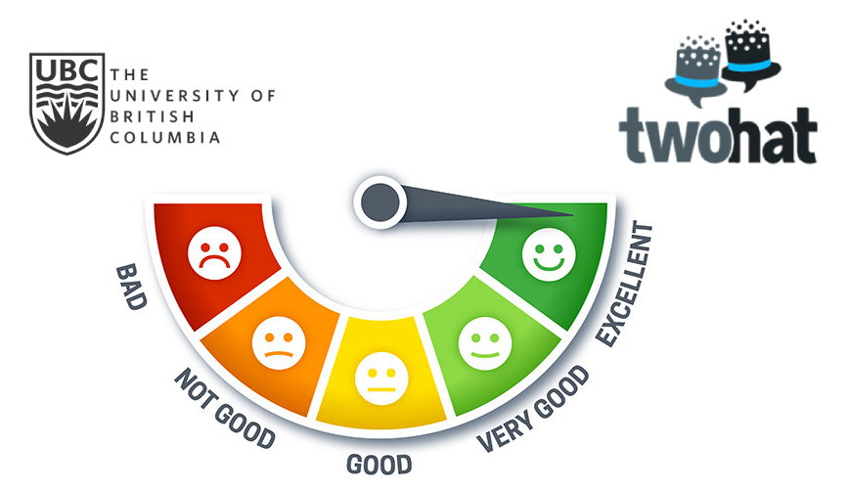

Identification of patterns and metrics to distinguish toxic and non-toxic Reddit communities
June 23, 2020
Bruno Santos Chris Donoff Elizaveta Volkova Sneha Mikkilineni Durga Swapil Paliwal
Notes:
Chris

Slide 2
Outline
Introduction
Motivation and Mission
Research questions and objectives
High level project overview
Project Details
Selection of communities
Tools and Data pipeline
Solution Workflow
Results
Trends of toxicity and sentiment
Effect of toxicity user activity and churn
Community response to toxic comments
Conclusion, Challenges & Future Work
Notes:
Chris

Slide 3


Community Health
Two Hat’s mission:
Help social networks build safe and healthy online communities
Find metrics that characterize the health of online communities
Capstone project mission:
Explore patterns and identify metrics that relate to the level of toxicity present in a community
Develop Community Health Toolkit
Introduction
Notes:
Chris

Slide 4

General Questions
Capstone Project Objectives
Community Health Toolkit
Levels of overall toxicity and sentiment
Effect of toxicity on user activity and churn
Community response to toxic comments
How do we measure community health?
How do we detect online harms?
What is the impact of online harms on communities?
Introduction
Notes:
Chris

Slide 5


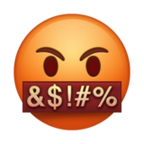



Project Overview
Select Communities
Toxicity & Sentiment
User Activity & Engagement
Growth & Churn
Integrating Results
Data Pipeline and Processing
Researched the topic pair of communities to identify differences
Prepared data for the analysis
Sentiment identifies toxic communities
Number of Active Users and Time-series of User Response
Increase and Drop in Users Activity and Subscription
Community Health Toolkit
Introduction
Notes:
Chris
“Here is an overview of the general steps we took to complete our project. We first researched and selected pairs of communities matched on theme, like religion, politics, or video games. We then created automated tools for cleaning our data and used tools to label our data, for example sentiment. We then defined metrics that fulfilled our project objectives, implemented them, and observed the resulting trends. We integrated the most important results into a community health toolkit, which provides the essential visualizations for characterizing communities. We will now go into more details on these steps, starting with community selection.”
Animate
Gather User Activity -> Toxicity Sentiment to Identifuing patterns of toxic/non toxic communities

Slide 6


Non-toxic
Toxic
r/truegaming
r/gaming
r/buddhism
r/atheism
r/PoliticalDiscussion
r/the_donald
Introduction
Project Details
Notes:
Liz
During our community selection, we did some research of reddit communities and selected the most toxic and the least toxic community in each theme based on Reddit Users opinion and Information from some articles. The correct selection of communities was important as otherwise we would not be able to see the similarities and differences in the analysis performed.
Click
Positive Truegaming and Toxic Gaming were selected in Video Games theme,
Click
healthy buddhism was an opposite to Negative atheism religion subreddits while
Click
PoliticalDiscussion was an opposite to Toxic the_donald in politics theme.
Animate: Non-Toxic / Toxic at the beginning -> TrueGaming, Gaming -> Buddhism, Atheism -> PoliticalDiscussion, the_donald

Slide 7

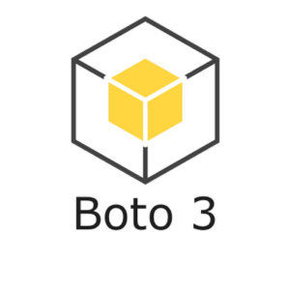
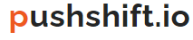
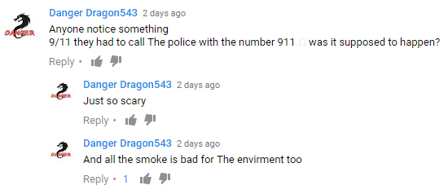


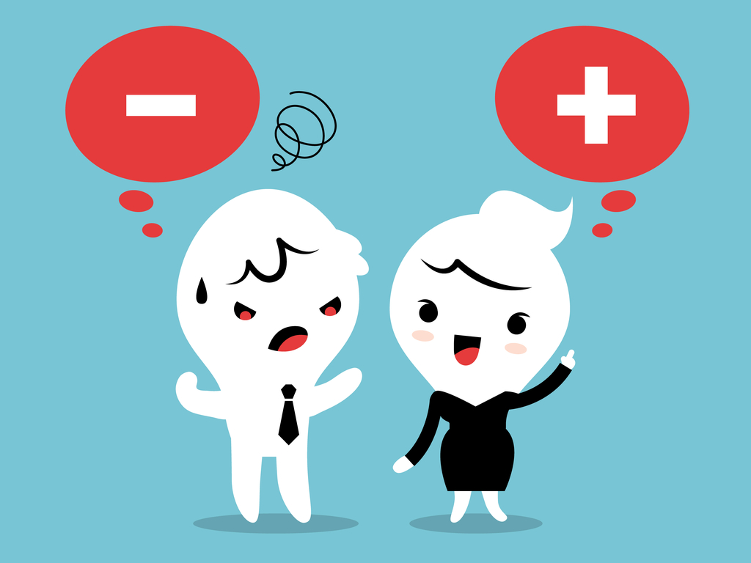



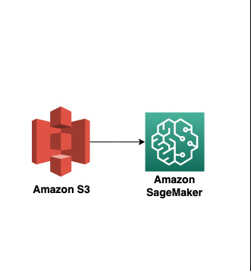






Tools and Data Pipeline
Comments (2014-2018)
Functions library
Two Hat Toxicity tool
Sentiment labelling
Introduction
Project Details
Notes:
Liz
After communities were selected, we used Python
Click
to pull its comments and submissions data for 2014-2018 years from Reddit via Pushsift API. Here you can see how Reddit comments look like - you can have a comment with some comments as response to it.
Click
After we pulled the data, we created library of functions to gather and clean the data.
Click
Later we used Two Hat Sift labelling tool to get information about toxicity level of each comment - the least toxic comments had 0 level of toxicity whereas the most toxic ones were pointed at 7. Sift tool also provided us with the topic of toxicity: each comment was classified by Vulgarity, Dating, Bullying and Racism Toxicity.
Click
As the final step of our data processing, we used vader to sentiment label the comments - it helped us to identify the comments who were positive or negative.
Click
In terms of our data architecture, we used Cloud Computing to securely access and work with the data: the Amazon S3 bucket was used to store our data while Amazon Sagemaker provided the access to coding resources.
Click
We used Power BI to create Interactive dashboards for our Community Health Toolkit.
Click
We stored our codes in GitLab to easily access them and version control.
Click
Finally we documented our results on Confluence Pages
Click
and provided the developed Community Health Toolkit

Slide 8





Solution Workflow
What metrics signal community health?
+/- Comment Ratio
Toxicity Rate
Ensemble of useful metrics for characterizing communities
Question
Metric
Toolkit
Definition
Visualization
Sentiment
Topic of Toxicity
(Vulgarity, Bullying, etc.)
Interactive Visualization Dashboards
Business Requirements
Introduction
Project Details
Notes:
Liz
Our toolkit was built in multiple steps: first of all we gathered clients business requirements to answer some high-level questions about Community Health and come up with business solutions on how to measure it.
Click
Each high-level question needed to be defined in a few different ways for deeper analysis and conclusion base.
Click
We defined those questions into different question groups, such as Sentiment, Toxicity, users activity and others.
Click
And Created the metrics matching those definitions.
We counted the defined metrics for all the selected communities and
Click
visualized our results on interactive bi dashboards.
Click
Finally, we gathered all the metrics to a single toolkit that helps to characterize communities.

Slide 9
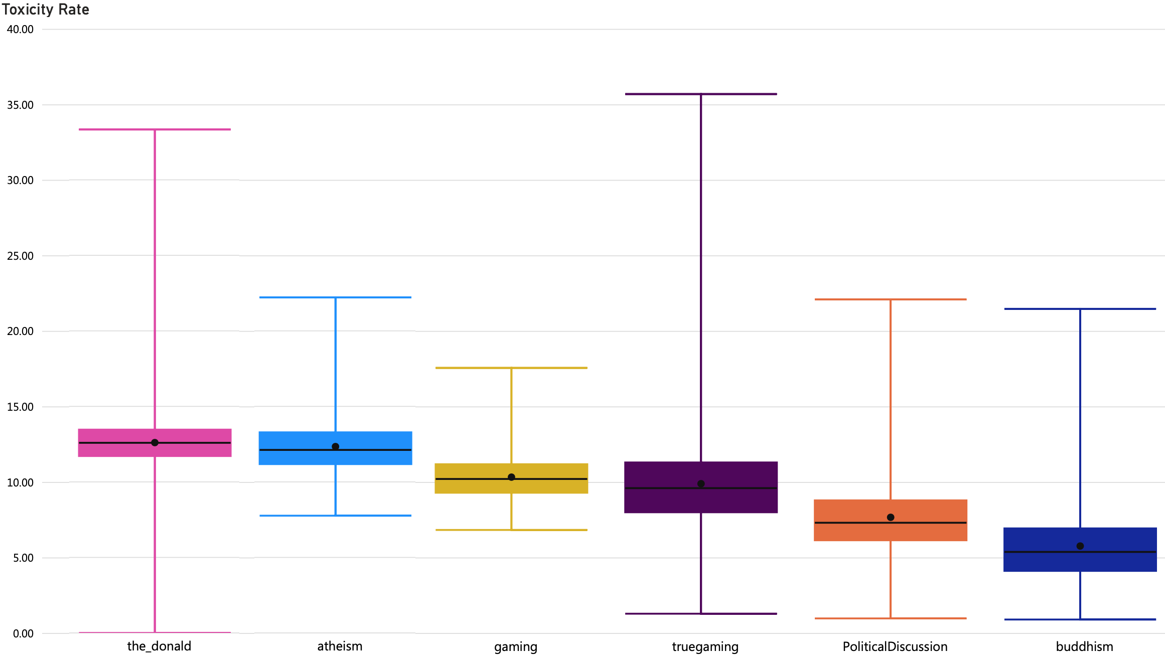
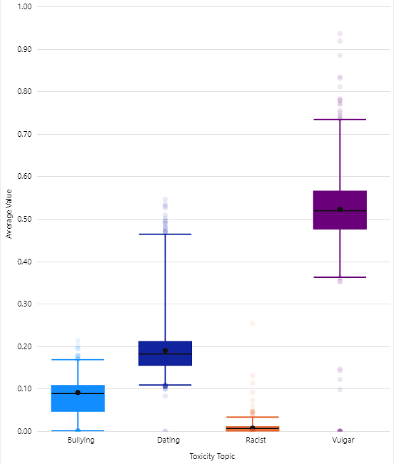

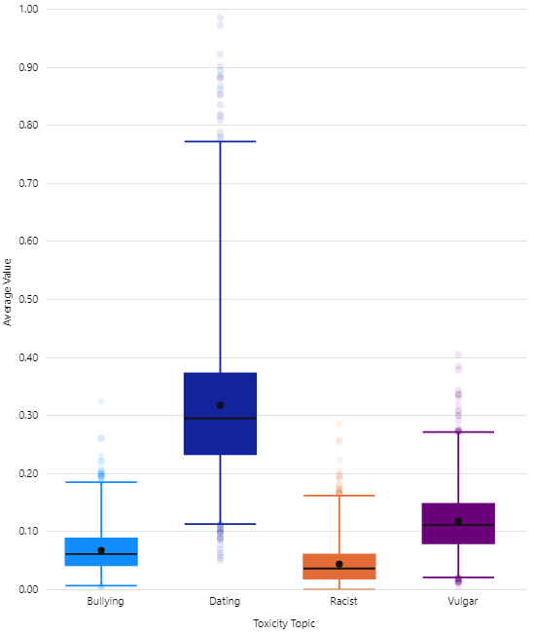

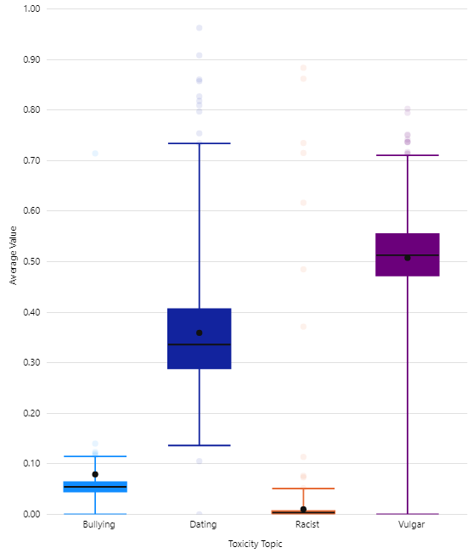
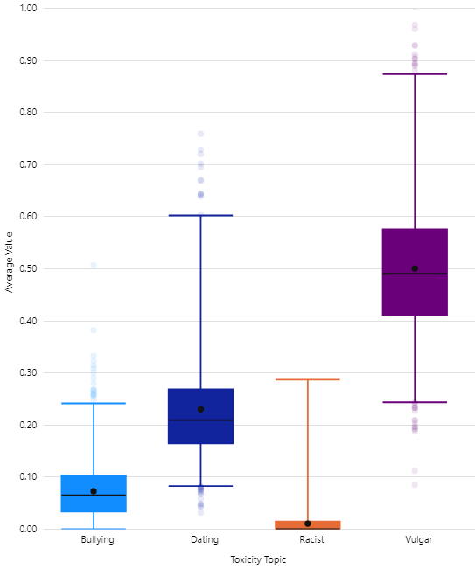

Toxicity Trends can indicate Community Health
(number of toxic comments / total number of comments)
Atheism
Buddhism
Gaming
TrueGaming
Introduction
Introduction
Project Details
Project Details
Results
Results
Notes:
Bruno
In our toolkit, one way of high-level identification of the health of communities is the toxicity rate. Here we can see the toxicity rate for all the communities. Toxicity rate is the number of toxic comments divided by the total number of comments. The lines from the edge are the minimum and maximum values ​​and, in the center of the box, we can see the median value. The width of the box indicates the variation of toxicity level of the community. To begin with, we have:
Atheism and Buddhism: we can see that Atheism has higher toxicity compared to Buddhism;
For politics, we see that The_Donald is more toxic;
Coming to Video Games topic we can say that both Gaming and TrueGaming have similar toxicity rate, but Gaming toxicity rate is slightly higher.
--------
Here’s a general trend of toxicity across all the communities as a big picture.
Show 2 pairs of slides for two themes (buddhism + atheism and gaming + truegaming)
Keep y axis for pairs in same manner

Slide 10
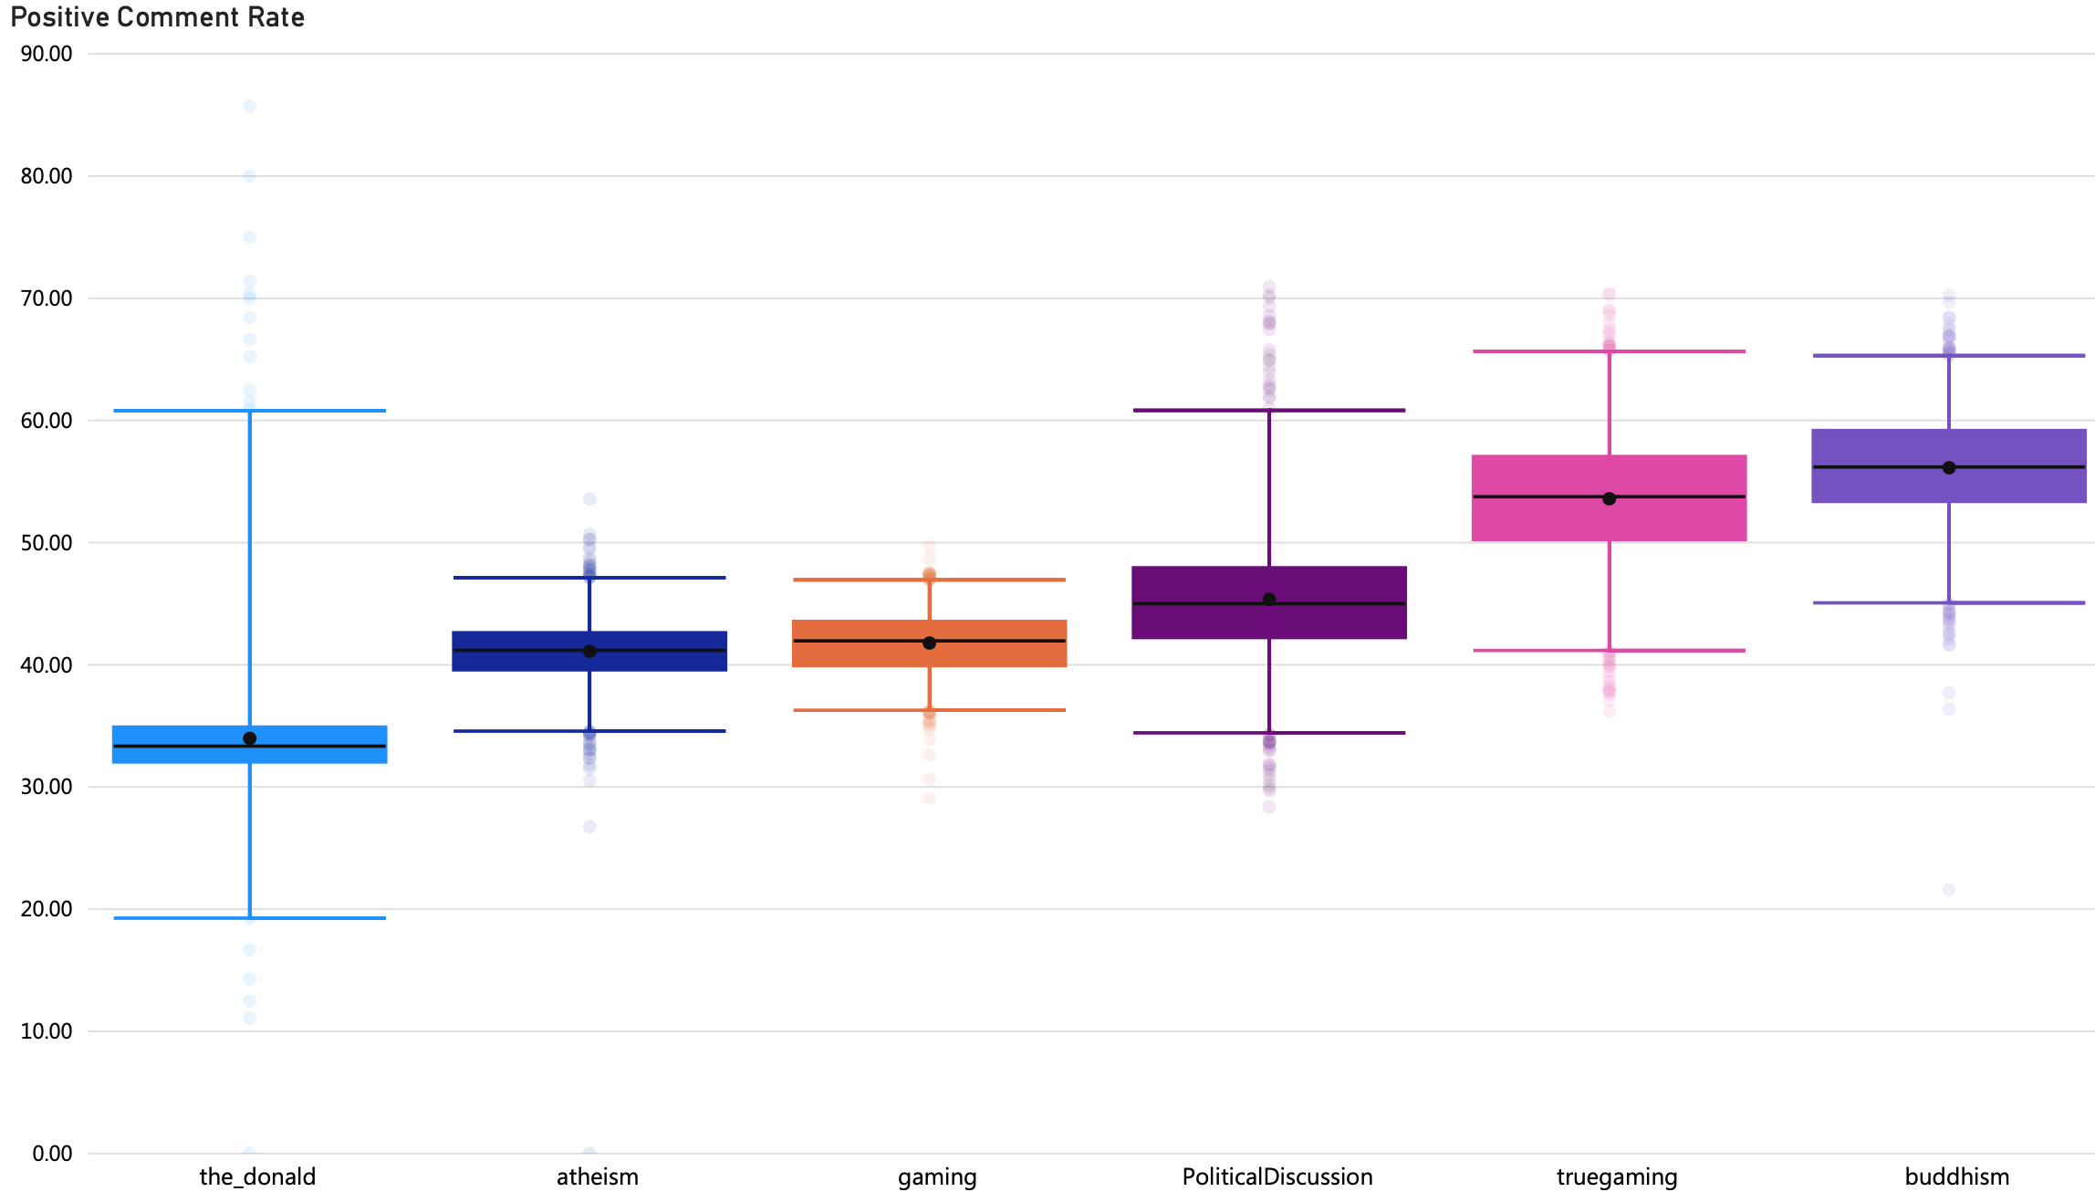
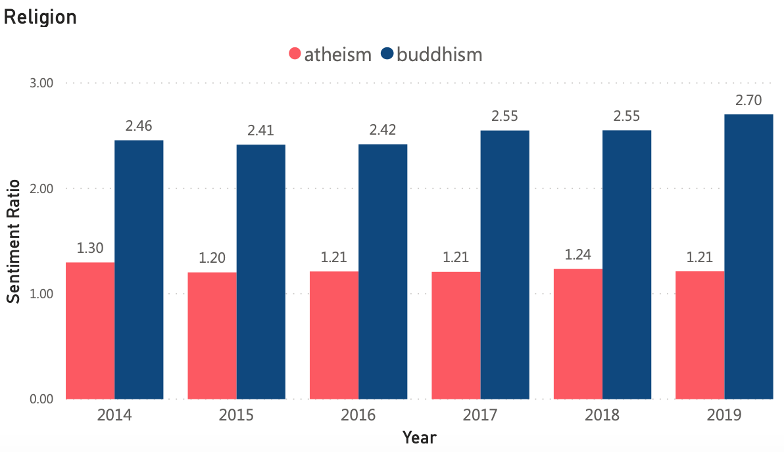
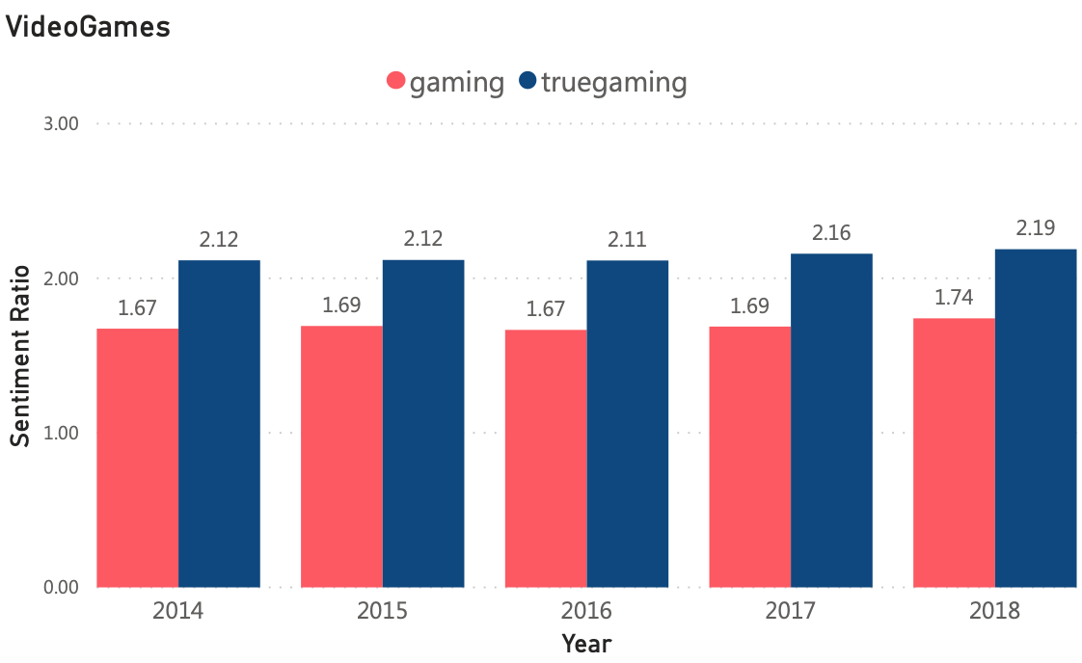
Sentiment can identify Community Health
Introduction
Project Details
Results
Notes:
Bruno
Sentiment is another feature of the Toolkit to characterize community health. As shown in the plot, we can clearly identify which communities are healthier by looking at the positive comment rate.
Buddhism has the highest positive comment rate as expected, followed by TrueGaming, PoliticalDiscussion, Gaming and Atheism. The_Donald has the lowest positive comment rate, but also has a lot of outliers.

Slide 11
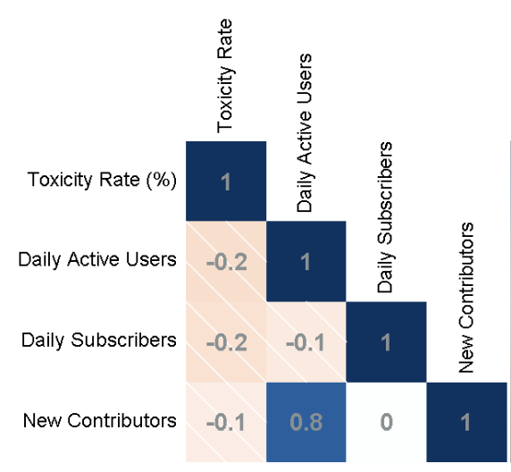
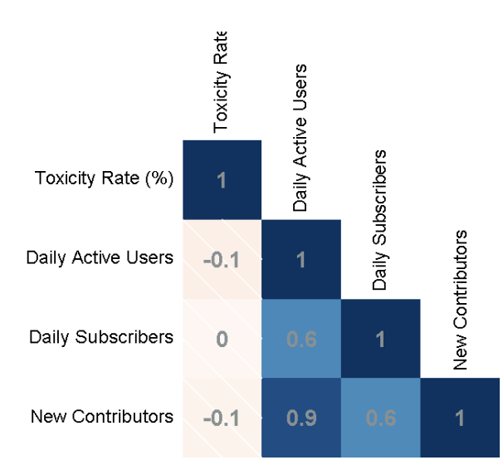
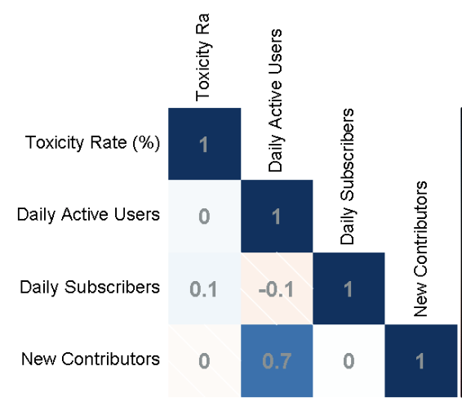
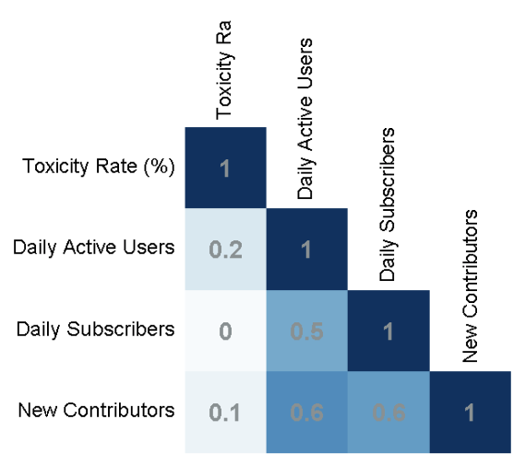
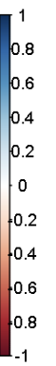
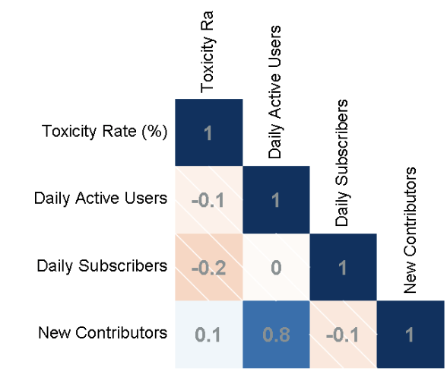
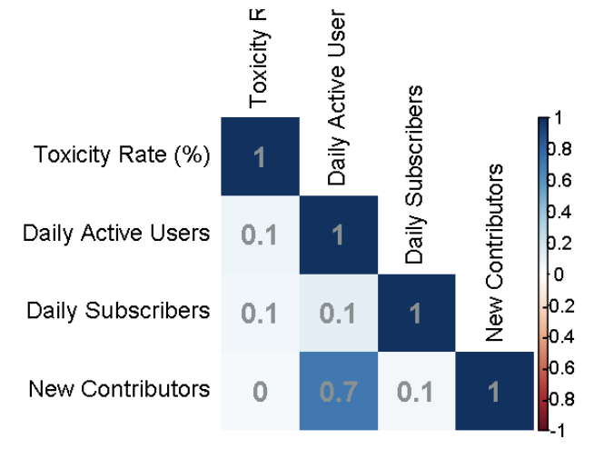
Toxicity effect on Users Activity & Community Growth
PoliticalDiscussion
Atheism
Strong positive effect
Buddhism
Gaming
TrueGaming
the_Donald
Daily Active Users are not affected by Daily Toxicity Rate
Increase of Active Users attract New Contributors
Daily Subscribers relationship to Active Users vary between communities
Strong negative effect
Introduction
Project Details
Results
Notes:
Sneha
Firstly, explain what is correlation plot and what dark blue, white and dark red means.
Then:
Gaming:
No relationship between Toxicity Rate and any Users Activity ->Toxicity doesn’t affect Users Activity
No relationship between Daily Subscribers and Daily Active Users
Increase in Daily Active Users attracts a lot of New people to comment in the community for the first time and hence the overall community growth
TrueGaming:
No relationship between Toxicity Rate and any Users Activity ->Toxicity doesn’t affect Users Activity
No relationship between Daily Subscribers and Daily Active Users
Increase in Daily Active Users attracts a bit less New people to comment in the community for the first time compared to Gaming. This increase also results in the overall community growth
Atheism:
No relationship between Toxicity Rate and any Users Activity ->Toxicity doesn’t affect Users Activity
No relationship between Daily Subscribers and Daily Active Users
Increase in Daily Active Users attracts a lot of New people to comment in the community for the first time and hence the overall community growth
Buddhism:
No relationship between Toxicity Rate and any Users Activity ->Toxicity doesn’t affect Users Activity
Increase in Daily Active Users attracts a lot of New Subscribers
Increase in Daily Active Users attracts more New people to comment in the community for the first time compared to Atheism. This increase also results in the overall community growth
Increase in Daily Active Users and New Contributors affect the community growth on the Subscription Rate - in the days with higher levels of daily active users more users subscribe within the community.
the_Donald:
No relationship between Toxicity Rate and any Users Activity ->Toxicity doesn’t affect Users Activity
Increase in Daily Active Users slightly attracts a bit of New Subscribers
Increase in Daily Active Users attracts less New people to comment in the community for the first time compared to all the other communities.
Increase in Daily Active Users and New Contributors affect the community growth on the Subscription Rate - in the days with higher levels of daily active users more users subscribe within the community.
PoliticalDiscussion:
No relationship between Toxicity Rate and any Users Activity ->Toxicity doesn’t affect Users Activity
No relationship between Daily Subscribers and Daily Active Users
Increase in Daily Active Users attracts a lot of New people to comment in the community for the first time

Slide 12
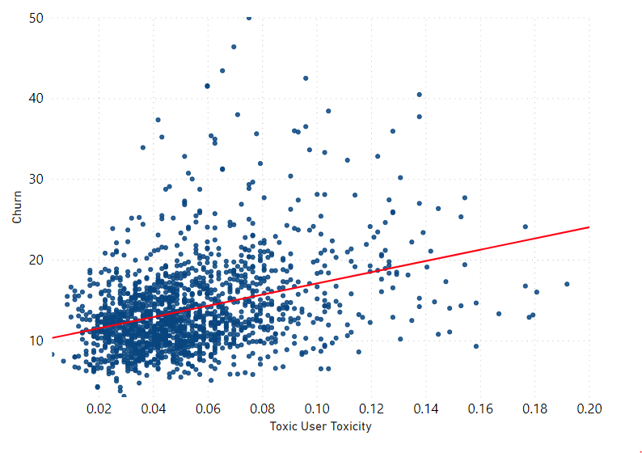
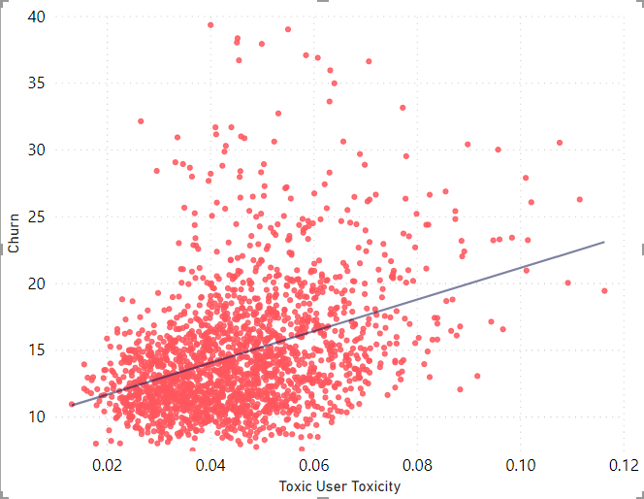
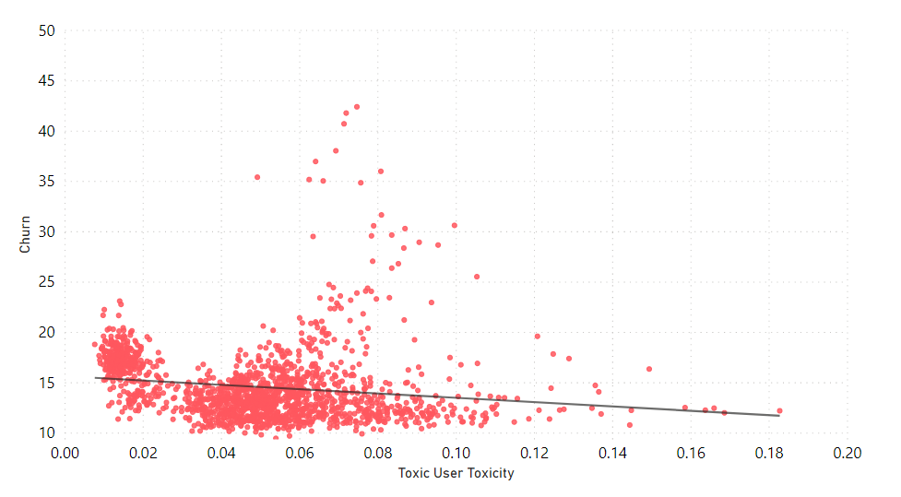
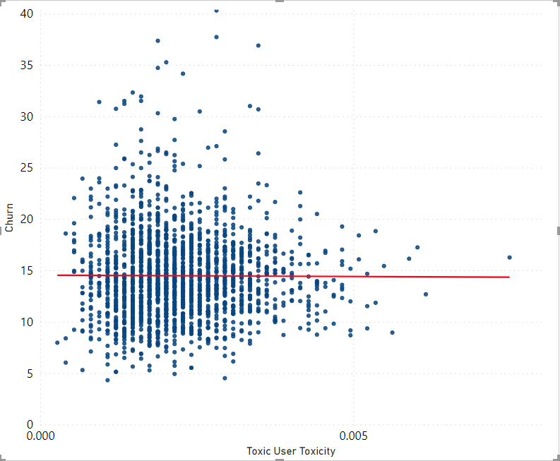
Effects of toxicity on Churn
Religion
Video Games
Atheism
Buddhism
Gaming
Truegaming
VS
Positive Correlation
Positive Correlation
Negative Correlation
No Correlation
Introduction
Project Details
Results
Notes:
Sneha
First Click:
Definition of churn:
Churned users are defined as the users who stopped commenting to the community. So, if a user stops commenting today, because of toxicity in the community, and continues to stop for the next consecutive 6 months, he will be considered churned in the 6th month. Losing users from contributing to the community is concerning. Analysing the factors that affect it, is important. Let’s analyse the impact of toxicity on churn for Games and Religion themes. Usually, it is a general notion for us to assume that, users in a community with high toxicity, churn the most. So, these scatter plots have the toxicity contributed by the toxic users on x-axis vs churn on the y-axis
Games : Gaming vs Truegaming
Gaming, a toxic community: As we can see, the trend goes down, which means that, toxicity is inversely correlated to churn. So, as the toxicity increases, interestingly, people churn less. People seem to be more engaged in toxic conversations, which is contradictory to our assumption.
Truegaming, a non-toxic community: In contrast to the toxic community, is the non-toxic community- Truegaming, which seem to show that churn has a positive correlation with toxicity, so as people start to contribute toxic comments, users tend to leave the community, may be, because this community seems to dislike having toxic conversations in the community, which supports our hypothesis.
Second Click:
Religion : Atheism vs Buddhism
Atheism, a toxic community: Atheism also shows a positive relation with toxicity. So, even though Atheism is a toxic community, people stop contributing as the toxicity in the community increases. This is a community where toxicity is high, but people dislike having toxicity in the community, only because of few toxic users, toxicity seem to be high and against the choice of other users.
Buddhism, a non-toxic community: Buddhism is considered to be one of the most calmest community. If we look at the scatter plot on the right, churn absolutely shows no correlation to toxicity. Interestingly, users in this community, seem to not bother if toxicity increases or decreases in the community, they stop contributing when they wish and doesn’t depend on the toxicity levels in the community.
***Politics theme of community, which are Political Discussion and The Donald, shows negative correlation with toxicity. Both communities seem to be happy with having toxic conversations, just that, the degree of toxicity in either of the communities that changes.
Interestingly, with both Atheism and The Donald are toxic, and have same like-minded users in both of them, but, all Atheism users dislike toxicity but, the donald users are like toxicity***
Conclusion:
People stopping to contribute in the community is mostly community specific

Slide 13
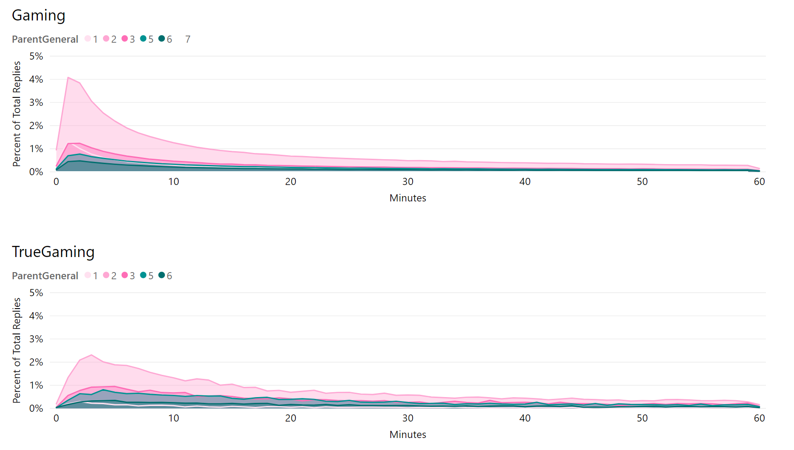
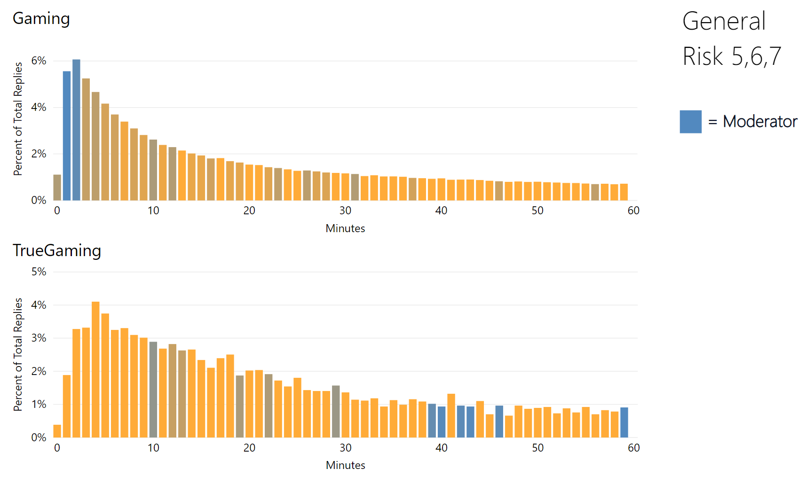
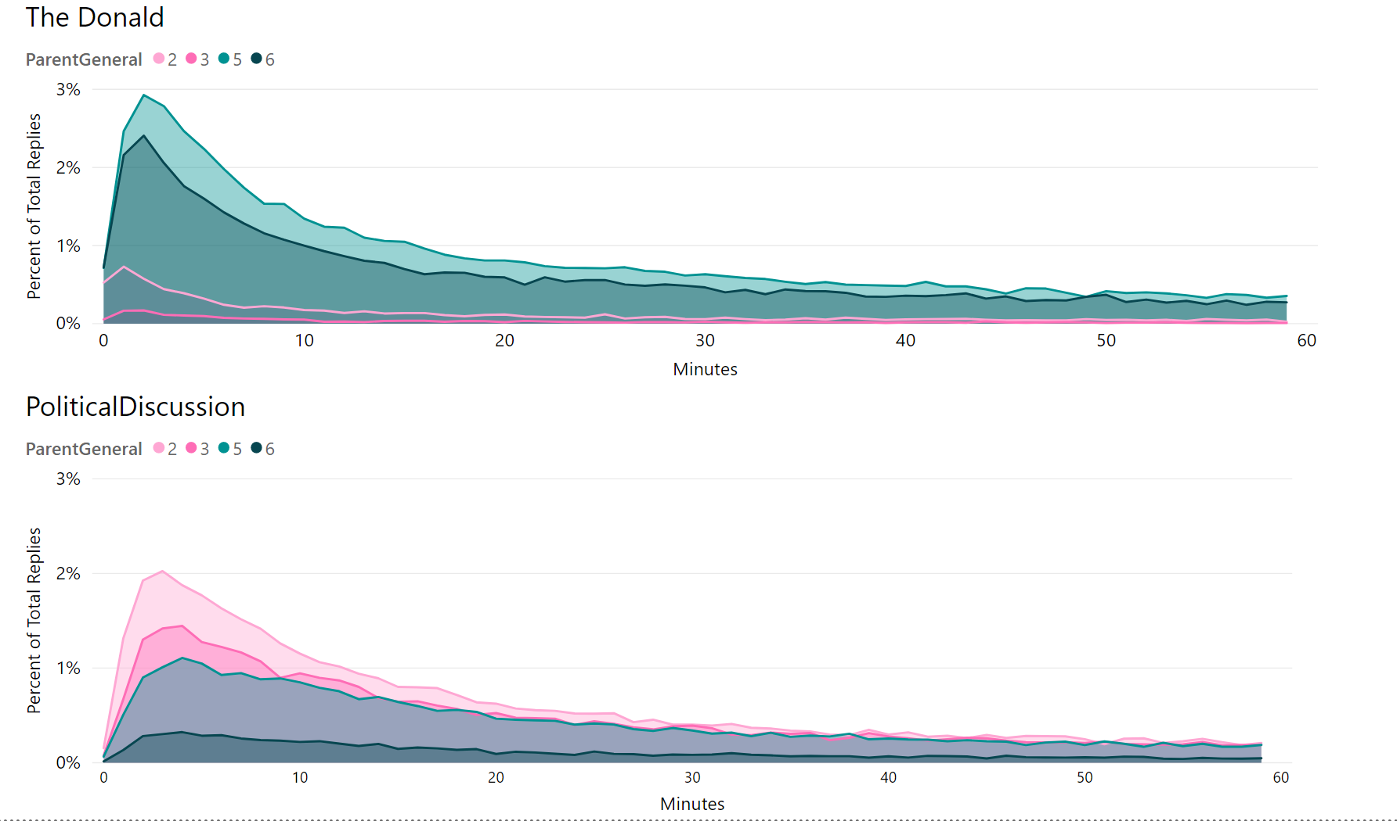
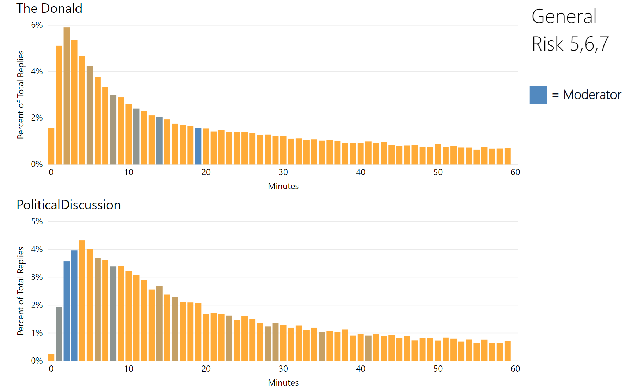
Response to Toxicity - Users
Response to Toxicity - Moderators
Introduction
Project Details
Results
Notes:
Sneha/Swapil (~2 mins)
Sneha has 1-2 (~1 min)
Swapil has 3-4 (~1 min)
Gaming versus Politics comparison:
First Animation: Here we are looking at the the time-series of percentage of replies to parent comments varying in general risk-level. We see that both video game communities show more replies to low-risk comments, whereas….
Second Animation: when we look at The Donald compared to PoliticalDiscussion, we see The Donald depicts a lot of replies to high-risk comments, whereas PoliticalDiscussion shows a mirrored trend.
Third Animation: Looking at the onset of moderator response, Gaming shows an earlier onset to moderator replies compared to the less toxic community TrueGaming. This would lead us to hypothesize that a higher prevalence of toxicity results in a more responsive team of moderators. However…
Fourth Animation: When we look at The Donald, their moderators reply slower compared to political discussion, further characterizing The Donald as a community of like-minded users, moderators included.

Slide 14

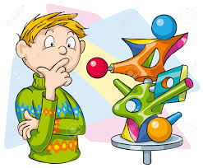



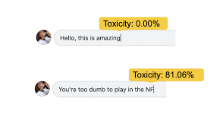



Conclusions - Solution
Research questions
Toxicity analysis
Sentiment analysis
Deeper community analysis
Community Health Toolkit
Introduction
Conclusion, Challenges & Future work
Project Details
Results
Notes:
Swapil ----
By this time we assume that some of the audience might be feeling a little lost, some may be with us and wondering where is this leading to, some may be feeling like the guy in middle, and most of us would be happy already that this is all coming to an end and might have already starting to think about the upcoming summer vacation.
We went through a similar journey and emotions through out the project.
As we started with business requirements and research questions we were confused on which metrics to evaluate and what can indicate a communities health in best manner, then once we were trying to analyse community trends and dynamics we were like the guys in middle as we initially got some clear patterns about toxicity and sentiments in the community pairs and that got us pretty curious but then deeper analysis revealed that the toxicity and sentiments didn’t always have a strong correlation with growth, engagement or churn and that was a hair pulling moment for us but we kinda expected that. We found that some toxic communities behaved in very different manner vs others and sometimes there were similarities between a toxic and non-toxic communities… for example users in the_donald and buddhism seemed unaffected by toxicity, whereas in atheism we saw a higher churn as toxicity rose.
Hence the idea of toolkit for community health arose and that made more sense for understanding community dynamics and we hope that this kit will enable community managers to get more insights and help customers/users feel like the emoticon guy on the right.

Slide 15
Conclusions - Generic Insights and details
Main Observations
Sentiments and toxicity provide consistent patterns of health
They aren’t always indicative of churn, engagement or growth
Other Interesting insights
Higher Active Users → More New Contributors
More Subscribers doesn’t mean Active Community
Some communities are attracted to toxicity
Community Health Toolkit
A Collection of visualizations from toolkit will provide community managers a more accurate assessment of community health
Introduction
Conclusion, Challenges & Future work
Project Details
Results
Notes:
Here are some key observations and insights but if there is one key thing we want you to take away then it is the community health toolkit will keep users and community managers happy.
That people might love engagement in toxic discussions or communities may not be affected by toxicity as all hence we needed toolkit.

Slide 16
Conclusions - Community Insights from toolkit
Community Health Toolkit is
Toxicity on certain topics (vulgarity, bullying) can hint about community’s health but this can vary based on domains
Sentiments are a clear indicator of communities health
As toxicity level increases the sentiments tend to go down.
The Donald demonstrates a like-minded, echo chamber
Daily Active Users are not affected by Daily Toxicity Rate
Increase of Active Users attract New Contributors
Daily Subscribers relationship to Active Users varies between communities
The_donald : moderator behavior is different.
Athiesm :
An ensemble of visualizations will provide community managers a more accurate assessment of community health
Echo chamber
Very negative
More moderation
Slightly negative
Getting popular
Very positive
Less moderated
More Positive
Getting better
Churn/user activity is unaffected by toxicity
Toxicity patterns are very similar
Moderators play a key role
Introduction
Conclusion, Challenges & Future work
Project Details
Results
Notes:
Swapil ---
I may exclude this but keeping it as placeholder for now.
Some key insights we derived about communities using the toolkit are
The_donald was a an echo chamber for like minded people and they usually don’t mind toxic conversations. The moderators don’t usually intervene either.
Buddhism community has an amazing overall positive sentiment and is also not affected by toxicity.
Gaming and true gaming are very similar and vulgar language a pretty common thing in both communities.
Gaming is ………………. While true gaming is ………………..
Atheism is …………………….
Political discussions is getting better as a community, people here do get affected by toxicity and moderators seem to have an important role

Slide 17
Challenges
Data challenges
Messy data (Inconsistent dates, data types, multiple sources etc.)
Debugging ( API Limitations, memory issues, size of data )
Resource limitations
Privacy, Security and licensing limitations for some tools like Tableau
Processing big files without a database
Topic based challenges
Diversity of community dynamics by themes
Community Health is a complicated topic and many more variables are at play besides toxicity
Introduction
Conclusion, Challenges & Future work
Project Details
Results

Slide 18
Future Work
New features for toolkit
Retention metric and trends
PCA, factor analysis features
Influencers Impact
Effects of Controversiality
New areas to explore
Topic modelling (LDA)
Identification of sentiment groups that churn
Depth of discussion analysis
Application of toolkit to paid subscription communities + comparison with open communities
Network analysis
Introduction
Conclusion, Challenges & Future work
Project Details
Results

Slide 19



Acknowledgement
Liza Wood
Two Hat Research Team
Dr. Richard Khoury (University Laval)
Dr. Ramon Lawrence
Dr. Scott Fazackerley
Jeff Bulmer
Debangsha Sarkar
MDS Program Staff, faculty and Classmates

Slide 20



Slide 21

Thank you

Slide 22
Addititional Slides

Slide 23
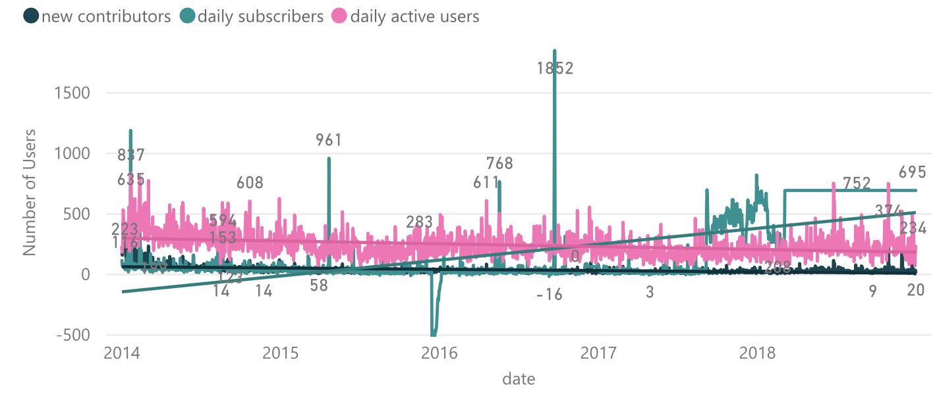
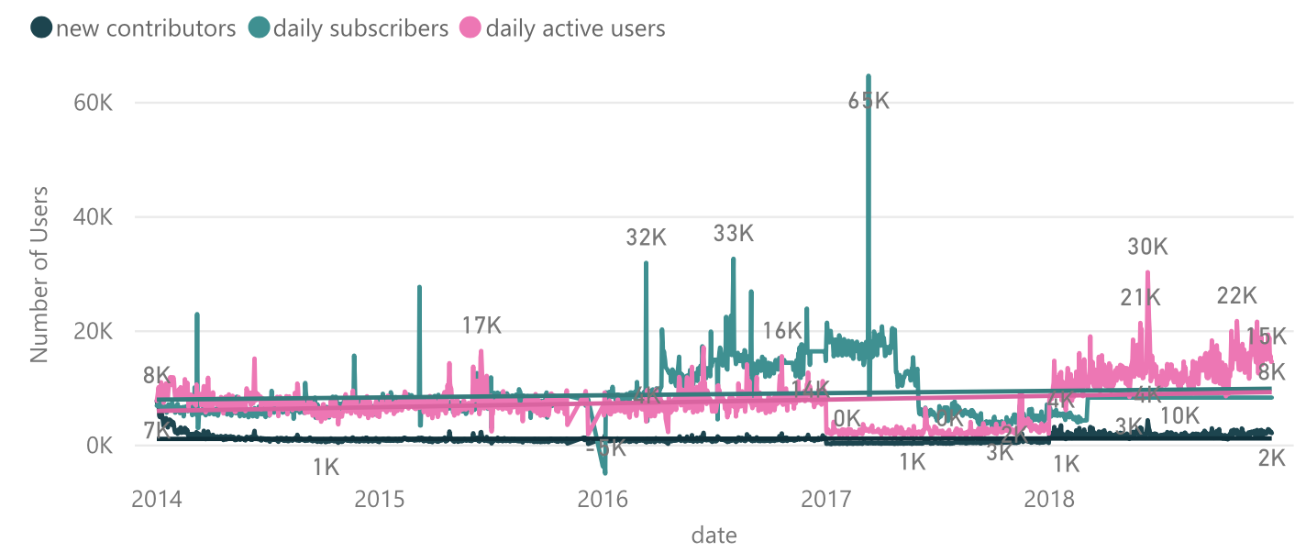
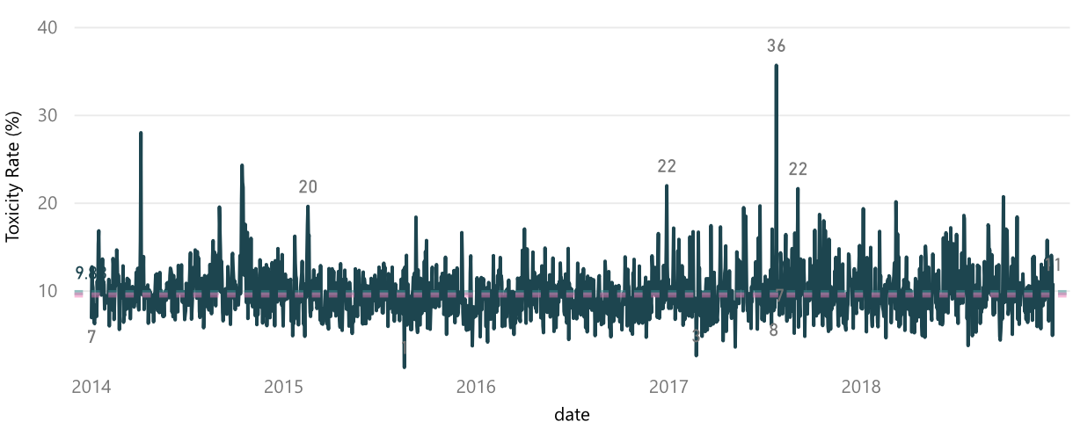
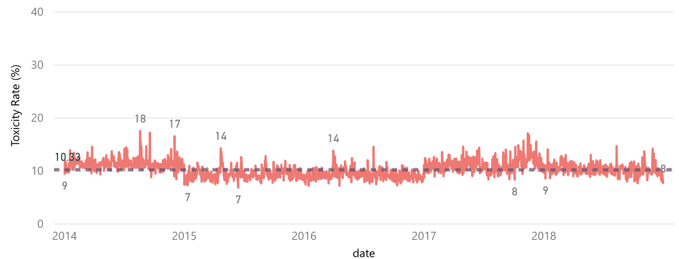
Toxicity effect on Users Activity & Community Growth
Truegaming
vs
Gaming
Users Activity
Users Activity
Toxicity Rate
Toxicity Rate

Slide 24
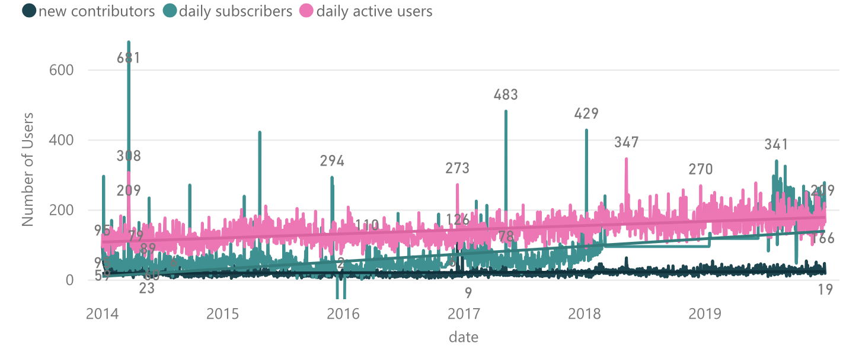
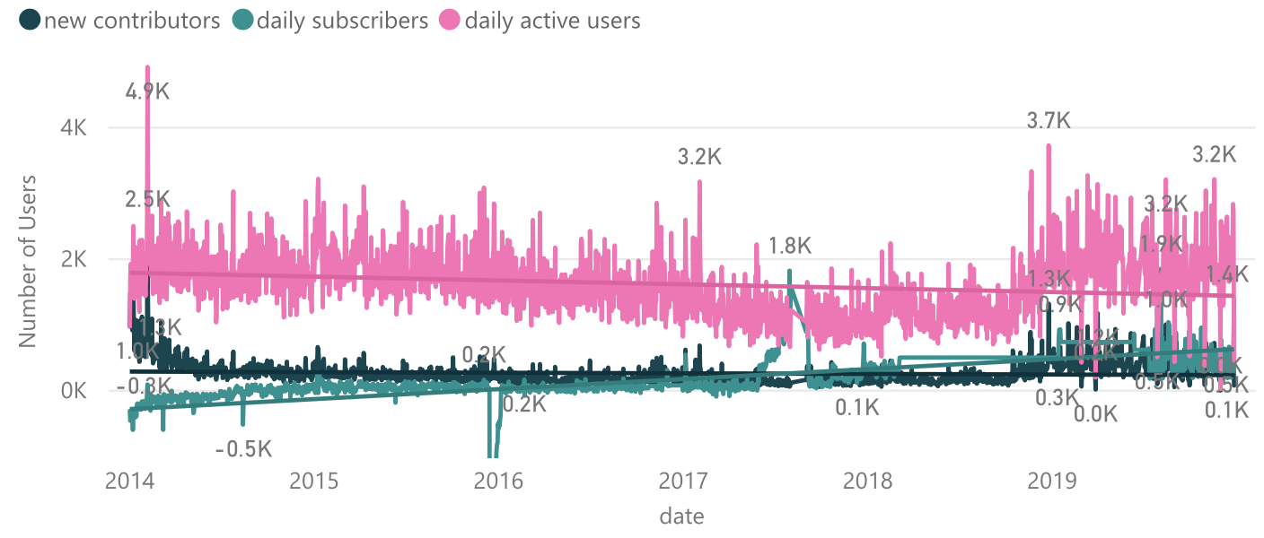
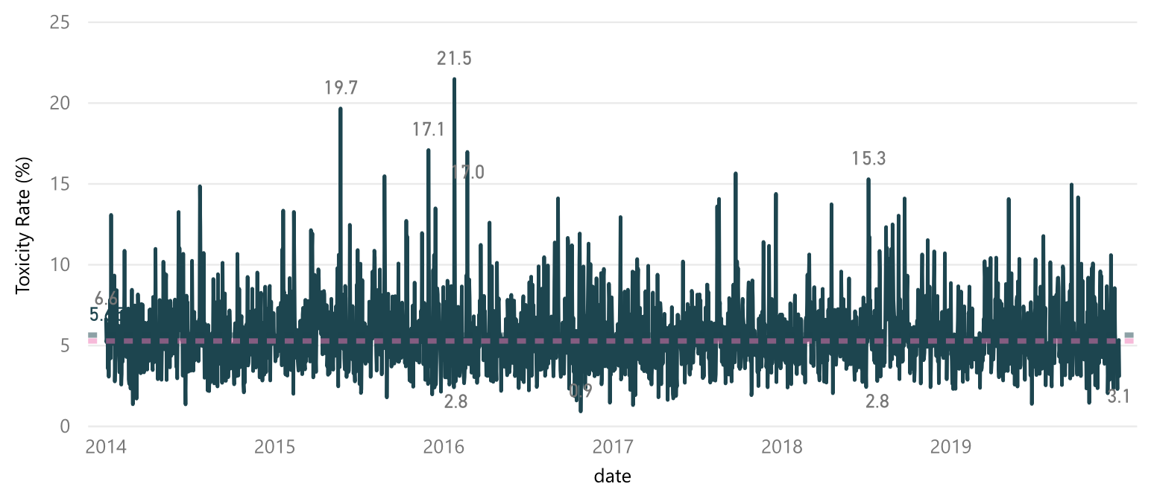
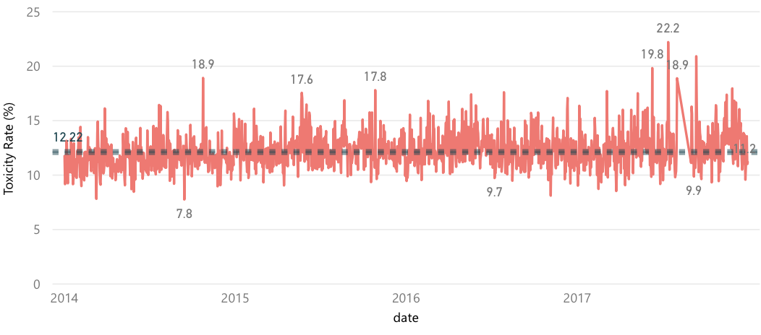
Toxicity effect on Users Activity & Community Growth
Buddhism
Atheism
Users Activity
vs
Users Activity
Toxicity Rate
Toxicity Rate

Slide 25
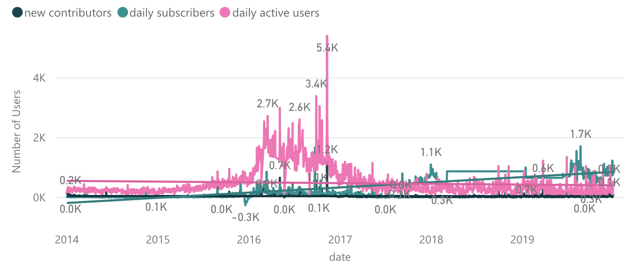
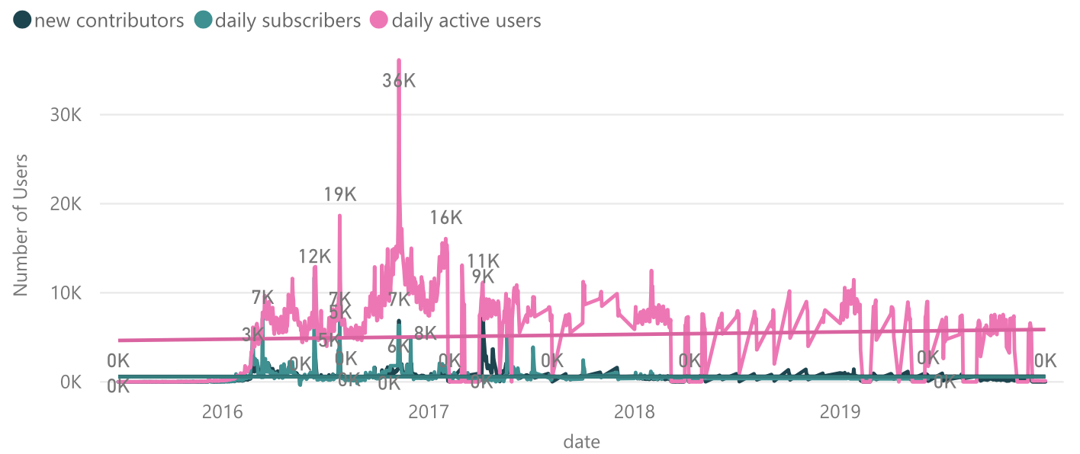
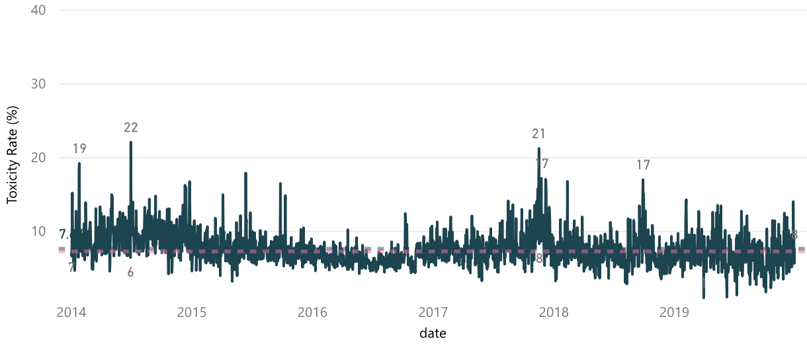
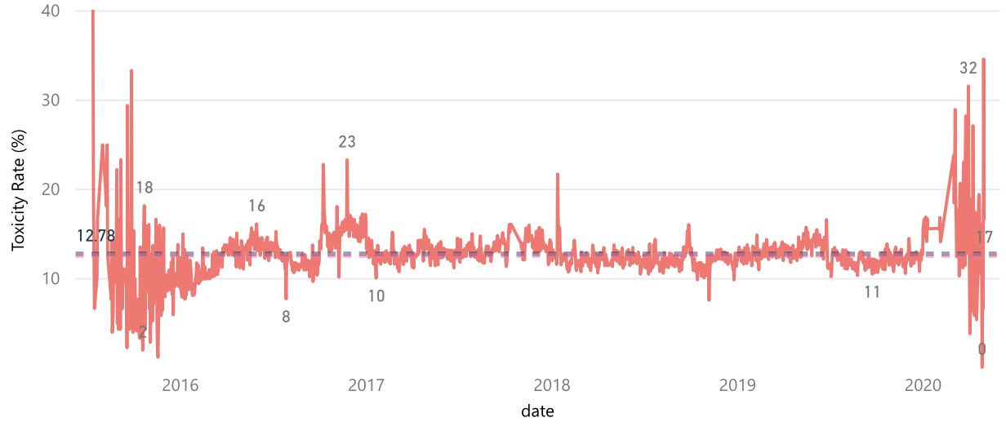
Toxicity effect on Users Activity & Community Growth
Political Discussion
the_Donald
Toxic User Toxicity Rate
vs
Toxic User Toxicity Rate
Toxicity Rate
Toxicity Rate

Slide 26
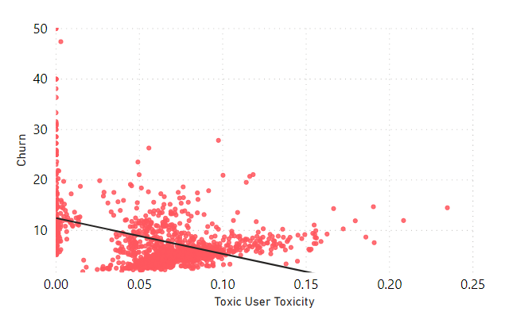
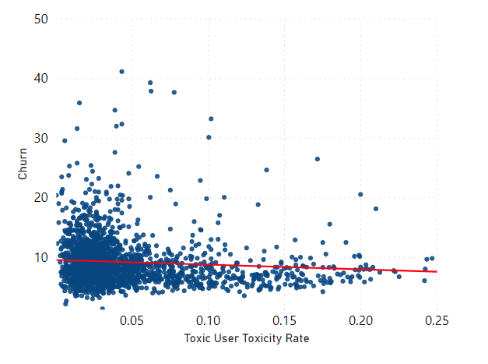
Churn : Effects of toxicity on Churn
Politics
The Donald
Political Discussion
VS
Negative Correlation
Weak Negative Correlation

Slide 27
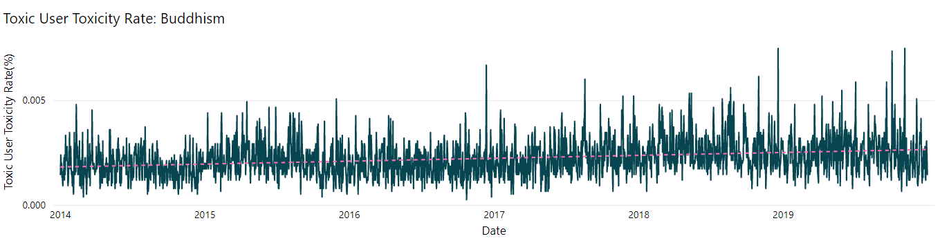
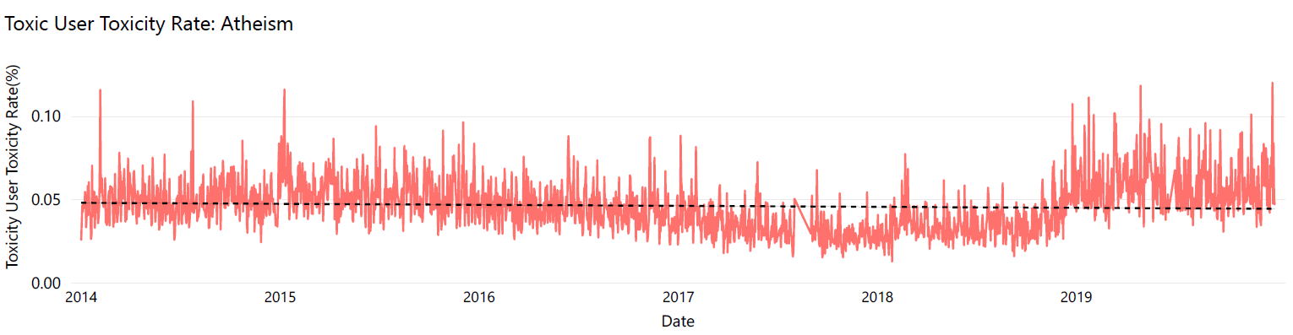
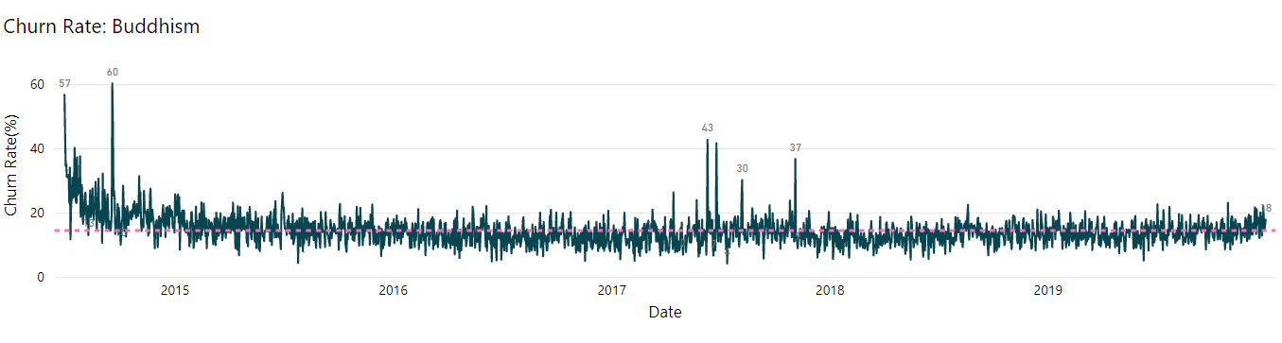
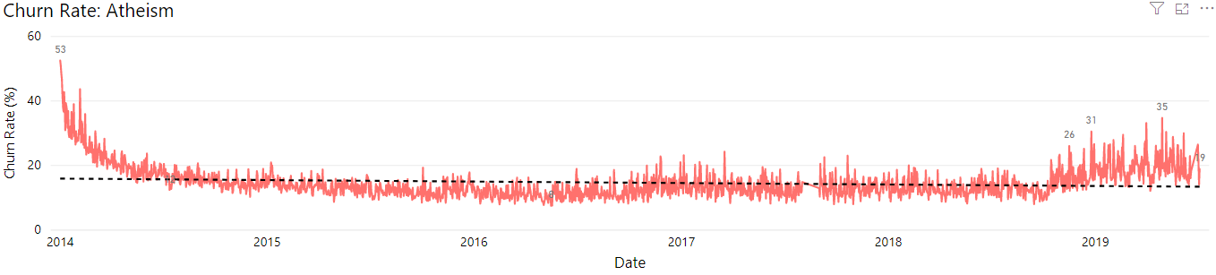
Churn : Effects of toxicity on Churn - Detailed View
Buddhism
Atheism
Toxic User Toxicity Rate
vs
Toxic User Toxicity Rate
Churn Rate
Churn Rate

Slide 28




Churn : Effects of toxicity on Churn - Detailed View
Truegaming
vs
Gaming
Toxic User Toxicity Rate
Toxic User Toxicity Rate
Churn Rate
Churn Rate

Slide 29




Churn : Effects of toxicity on Churn - Detailed View
Political Discussion
The Donald
vs
Toxic User Toxicity Rate
Toxic User Toxicity Rate
Churn Rate
Churn Rate

Slide 30

Sentiment vs toxicity
Introduction
Project Details
Analysis
Notes:
Bruno
I don't think it's a good idea to show this plot, because of the time and we will be able to explore it further in the report later. To show another comparison of the community on slide 10, we will already have 5 slides, this is the sixth.
Swapil :
The toxicity analysis will have to be 1 slide. Sentiment will be another…. We need to fit 4-5 separate slides into 2 only…. We can have only 2-4 analysis slides in total and we already have 3 after toxicity and sentiments….. Please try fitting similar themes in one slide….i can do that if needed…
Bruno:
I can merge my slides, but this does not mean that will shrink my presentation. I’ll still need to talk about the slides and I already have 4, plus the other community from the slide 10 (TrueGaming and Gaming). With that there are already 5 slides in 4 minutes. Like Professor Scott said we need to be clear and the slides needs to be well communicated. I still would like to present just 5 slides and not 6. The time is too small for that and we don’t have too much time to explain many details. This is a good slide to show on the report for sure, not here because of timing schedule that we have.
I'll need help in the others for sure, specially with the the new slides for community (Gaming and TrueGaming) from slide 10.
Thank you Swapil!

Slide 32
Conclusions - finer details
Main Observations
Sentiments and toxicity provide pretty consistent patterns
They are not always highly correlated to churn, engagement or growth
Other Interesting insights
Daily Active Users are not always affected by Daily Toxicity Rate
Increase of Active Users attract New Contributors
Daily Subscribers relationship to Active Users varies between communities
An ensemble of visualizations will provide community managers a more accurate assessment of community health
Community Health Toolkit
Introduction
Conclusion, Challenges & Future work
Project Details
Results
Notes:
Here are some key observations and insights but if there is one key thing we want you to take away then it is the community health toolkit will keep users and community managers happy.
That people might love engagement in toxic discussions or communities may not be affected by toxicity as all hence we needed toolkit.

Slide 33
Gaming
TrueGaming
Atheism
PoliticalDiscussion
Buddhism
the_Donald

Slide 34


The Donald
PoliticalDiscussions

Slide 35
Toxicity Trends can indicate Community Health
(number of toxic comments / total number of comments)
Introduction
Introduction
Project Details
Project Details
Results
Results
Notes:
Bruno
In our toolkit, one way of high-level identification of the health of communities is the toxicity rate. Here we can see the toxicity rate for all the communities. Toxicity rate is the number of toxic comments divided by the total number of comments. The lines from the edge are the minimum and maximum values ​​and, in the center of the box, we can see the median value. The width of the box indicates the variation of toxicity level of the community. To begin with, we have:
Atheism and Buddhism: we can see that Atheism has higher toxicity compared to Buddhism;
For politics, we see that The_Donald is more toxic;
Coming to Video Games topic we can say that both Gaming and TrueGaming have similar toxicity rate, but Gaming have a slightly higher toxicity rate.
--------
Here’s a general trend of toxicity across all the communities as a big picture.
Show 2 pairs of slides for two themes (buddhism + atheism and gaming + truegaming)
Keep y axis for pairs in same manner

Slide 36
Health by topics can give deeper insights
Atheism
Buddhism
Introduction
Project Details
Results
Notes:
Bruno
In a more detailed view, through the risk topic Vulgarity, we see that Atheism is more toxic than Buddhism. We can also see that Dating risk topic was higher.
--------
Vulgarity can distinguish between healthy and non-healthy ocmmunities.
Atheism vs buddhism comparison.
Gaming vs true gaming or donald vs political discussion.

Slide 37
Health by topics can give deeper insights
Gaming
TrueGaming
Notes:
In Gaming and TrueGaming we have similar toxicity rate in both communities. We can see three small differences: from Gaming, on the left side, bullying and vulgar are higher while dating is higher in truegaming, as shown in the plot on the right. We can conclude that Gaming is more toxic than TrueGaming.

Slide 38
Sentiment can identify Community Health
Introduction
Project Details
Results
Notes:
Bruno
Sentiment is another feature of the Toolkit to characterize community health. As shown in the plot, we can clearly identify which communities are healthier by looking at the positive comment rate.
Buddhism has the highest positive comment rate as expected, followed by TrueGaming, PoliticalDiscussion, Gaming and Atheism. The_Donald has the lowest positive comment rate, but also has a lot of outliers.

Slide 39
Sentiment can identify Community Health
Introduction
Project Details
Results
Notes:
Bruno
On this plot we see the sentiment ratio, which is the ratio between the positive and negative comments.
Observing religion communities - the plot on the left, we can conclude that Buddhism has a higher positive sentiment compared to Atheism, which means that Buddhism is a healthier community.
On the right side, we observe Video Game communities - as you can see, TrueGaming has higher positive sentiment than Gaming. Which leads us to conclusion that Truegaming is healthier community than the Gaming.

Slide 40

Sentiment can identify Community Health

Slide 41
Toxicity Trends can indicate Community Health
(number of toxic comments / total number of comments)
Atheism
Buddhism
Gaming
TrueGaming
Introduction
Introduction
Project Details
Project Details
Results
Results
Notes:
Bruno
In our toolkit, one way of high-level identification of the health of communities is the toxicity rate. Here we can see the toxicity rate for all the communities. Toxicity rate is the number of toxic comments divided by the total number of comments. The lines from the edge are the minimum and maximum values ​​and, in the center of the box, we can see the median value. The width of the box indicates the variation of toxicity level of the community. To begin with, we have:
Atheism and Buddhism: we can see that Atheism has higher toxicity compared to Buddhism;
For politics, we see that The_Donald is more toxic;
Coming to Video Games topic we can say that both Gaming and TrueGaming have similar toxicity rate, but Gaming toxicity rate is slightly higher.
--------
Here’s a general trend of toxicity across all the communities as a big picture.
Show 2 pairs of slides for two themes (buddhism + atheism and gaming + truegaming)
Keep y axis for pairs in same manner

